Slide 1
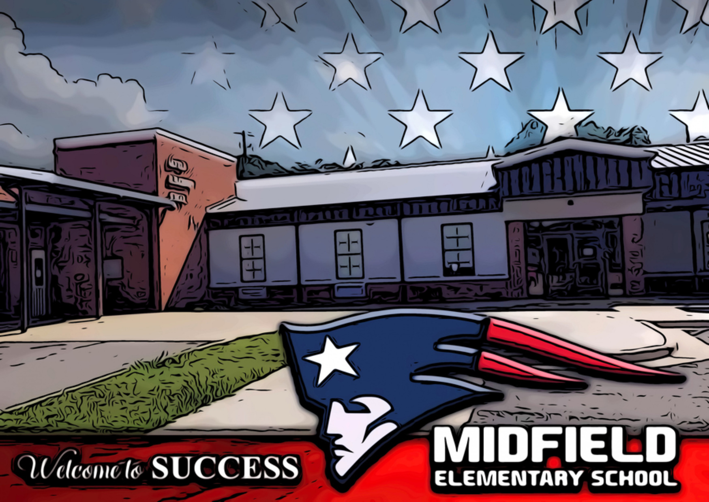
Explore Here!
Why Read?
Mission Statement
Goals
Standards
Use of Time
Community Supporters
Counseling Connection
Dec. 2020
J. Marshall, MES Counselor
M. Davis, Principal
K. Felton, Assistant Principal
K. Mathews, Counseling Director

Slide 2
Explore Here!
Why Read?
Mission Statement
Goals
Standards
Use of Time
Community Supporters
Why Read the Counseling Connection?
The purpose of the Counseling Connection is to virtually connect students, parents, community, and all other stakeholders to the Comprehensive School Counseling Program of Midfield Elementary School by sharing the following aspects:
Foundation
Management
Delivery
Accountability

Slide 3
Explore Here!
Why Read?
Mission Statement
Goals
Standards
Use of Time
Community Supporters
Mission Statement
The mission of Midfield Elementary School’s comprehensive school counseling and guidance program is to provide a structured program of services that supports the goal that every student graduates high school through being educated in a safe and productive learning environment.

Slide 4
Annual Student OUTCOME GOALS
Attendance
ELL
By the end of the 2020-2021 school year, 30% of students who were chronically absent will decrease absences by 3 days from 10 days of absence to 7 days of absence.
By the end of the 2020-2021 school year, 30 % of students who scored level 1 or level 2 will increase overall testing level by one level from 1 to 2 or 2 to 3.

Slide 5
Student Mindsets and Behaviors
Mindset Standards
Behavior Self Management Skills
Behavior Social Skills
Behavior Learning Strategies Standards
Self-confidence in ability to succeed
Sense of belonging in the school environment
Understanding that postsecondary education and lifelong learning are necessary for long-term career success
Positive attitude toward work and learning
Demonstrate ability to assume responsibility
Demonstrate self-discipline and self-control
Use effective oral and written communication skills and listening skill
Create Positive and supportive relationships with other students
Demonstrate critical-thinking skills to make informed decisions
Identify long-and short-term academic, career and social/emotional goals

Slide 6
Use of Time
Direct/Indirect 80%
Program Planning
15%
Non-Counseling Duties
5%
School Guidance Curriculum-provides guidance lessons to all students
Individual Student Planning-assists students in planning, monitoring, and managing their personal career planning
Responsive Services-addressed the immediate concerns of students
System Support- includes program, staff, and school support activities and services
Program evaluation, planning, and advertising
Fair share responsibilities are tasks that do not fall within any specific job description but are necessary for the operation of a school. These duties are shared among all faculty and staff members.

Slide 7
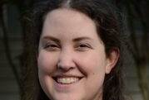
ACE
Ace (Alaquest Collaborative for Education) is a life skills education program that strengthens the Social Emotional well being of students. Lessons are given once a month during counseling time by the facilitators pictured.

Slide 8
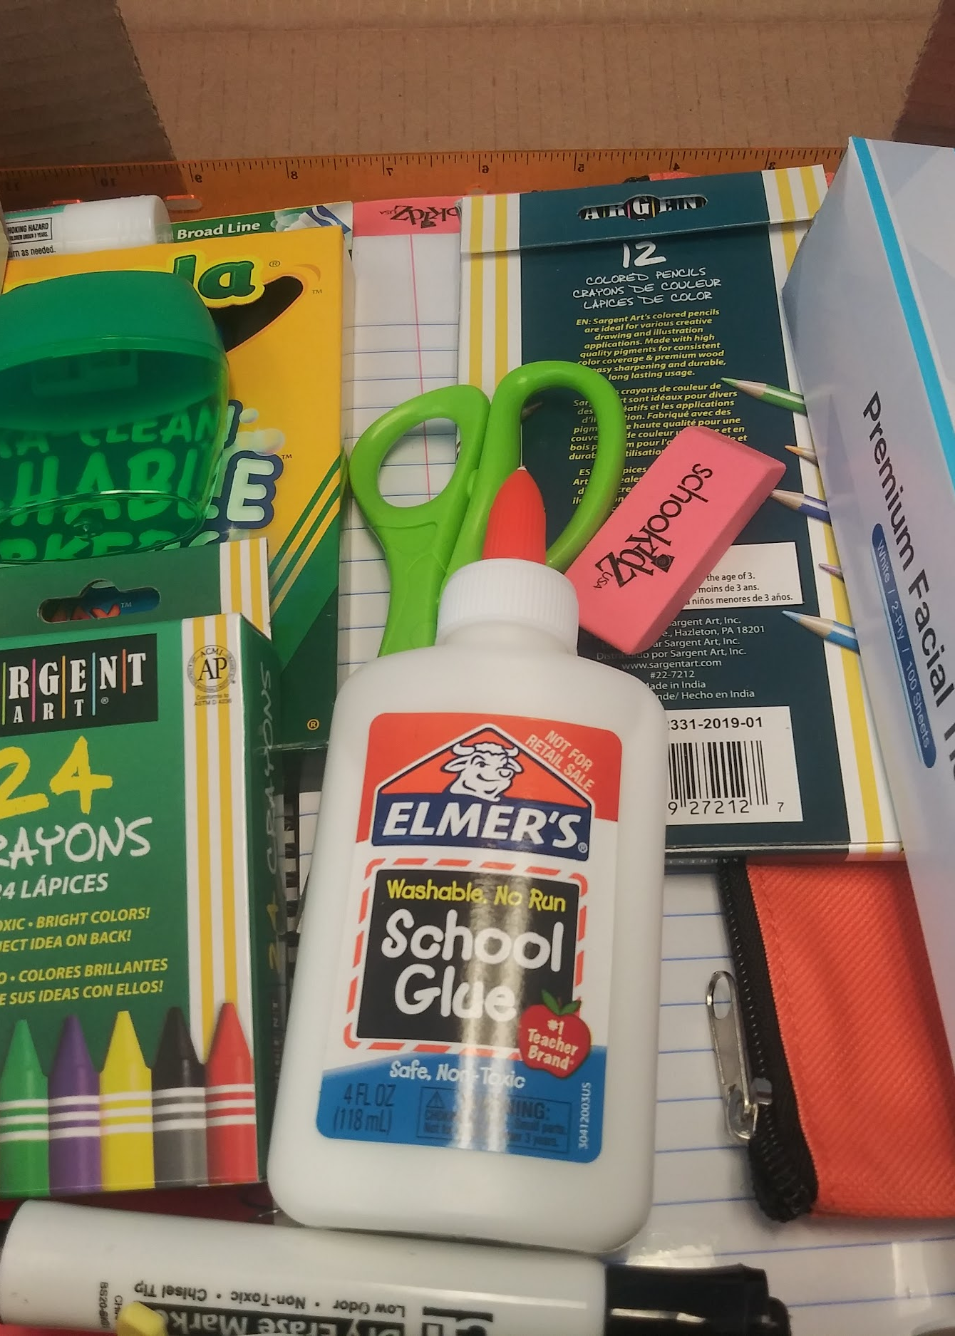
NEXT!
Special Thanks to the Mayor and City Council of Midfield for donating over 190 school supply boxes!

Slide 9
NEXT!
Special Thanks to the United Fellowship Community Baptist Church (UFCBC) for donating turkey dinners to students and families for Thanksgiving

Slide 10
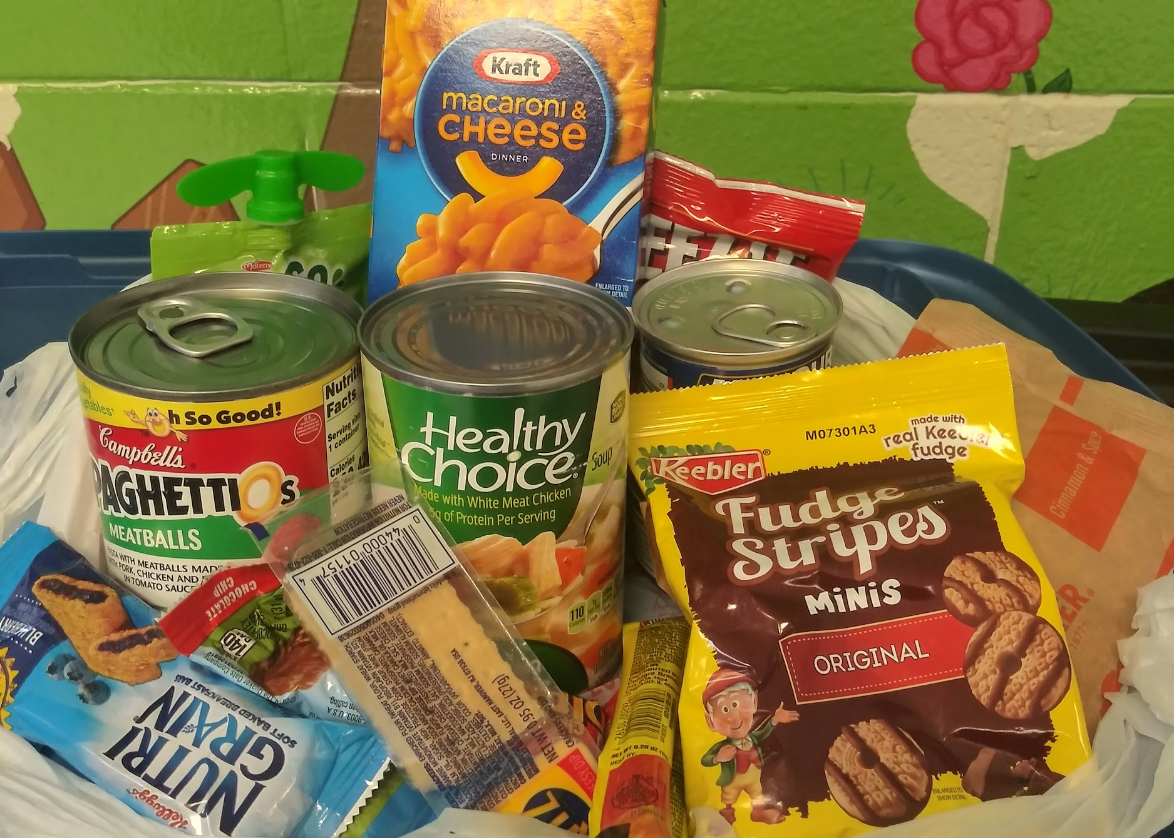
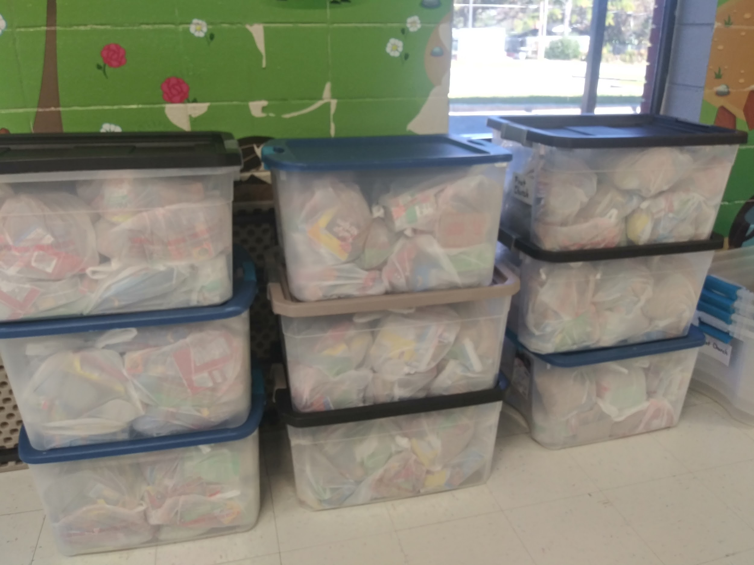
Home
Special Thanks to First United Methodist Church of downtown Birmingham. Weekly, they donate over 200 non perishable food bags for students to have over the weekend.

